Slide 1
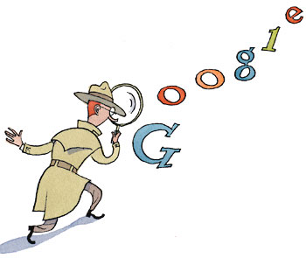
The Anatomy of a Large-Scale Hypertextual Web Search Engine
Faiz ul haque Zeya
From :
Sergey Brin, Lawrence Page
CS Department
Stanford University
Presented by Li An, CIS, TU

Slide 2
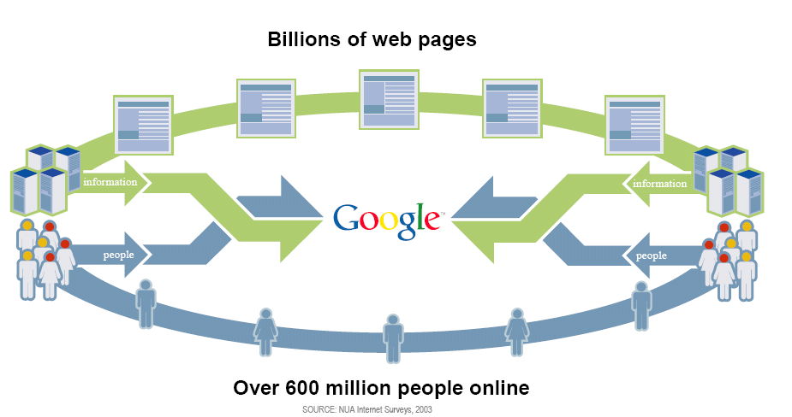
Introduction

Slide 3
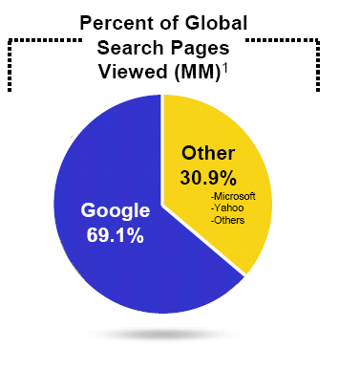
Introduction

Slide 4
Introduction
Google’s Mission
To organize the world’s information and make it universally accessible and useful
Scaling with the web
  Improved Search Quality
  Academic Search Engine Research

Slide 5
System Features
It makes use of the link structure of the Web to calculate a quality ranking for each web page, called PageRank
  PageRank is a trademark of Google. The PageRank process has been patented.
Google utilizes link to improve search results

Slide 6
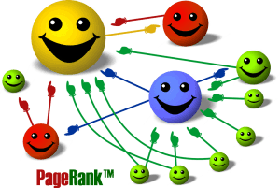
PageRank
  PageRank is a link analysis algorithm which assigns a numerical weighting to each Web page, with the purpose of "measuring" relative importance.
      Based on the hyperlinks map
      An excellent way to prioritize the results of web keyword searches

Slide 7


Simplified PageRank algorithm
Assume four web pages: A, B,C and D. Let each page would begin with an estimated PageRank of 0.25.
L(A) is defined as the number of links going out of page A. The PageRank of a page A is given as follows:
C
A
D
B
C
A
D
B

Slide 8

PageRank algorithm including damping factor
  Assume page A has pages B, C, D ..., which point to it. The parameter d is a damping factor which can be set between 0 and 1. Usually set d to 0.85. The PageRank of a page A is given as follows:

Slide 9
Intuitive Justification
A "random surfer" who is given a web page at random and keeps clicking on links, never hitting "back“, but eventually gets bored and starts on another random page.
  The probability that the random surfer visits a page is its PageRank.
  The d damping factor is the probability at each page the "random surfer" will get bored and request another random page.
A page can have a high PageRank
  If there are many pages that point to it
  Or if there are some pages that point to it, and have a high PageRank.

Slide 10
Anchor Text
<A href="http://www.yahoo.com/">Yahoo!</A>
Besides the text of a hyperlink (anchor text) is
associated with the page that the link is on,
it is also associated with the page the link
points to.
  anchors often provide more accurate descriptions of web pages than the pages themselves.
  anchors may exist for documents which cannot be indexed by a text-based search engine, such as images, programs, and databases.

Slide 11
Other Features
It has location information for all hits.
Google keeps track of some visual presentation details such as font size of words.
      Words in a larger or bolder font are weighted higher than other words.
Full raw HTML of pages is available in a repository

Slide 12
The Future
“The ultimate search engine would understand exactly what you mean and give back exactly what you want.”
- Larry Page

Slide 13

Thanks!

